Slide 1

WEEK 3 — LECTURE 5 & 6
Artificial Intelligence
Intelligent Agents and Environment Properties
Understanding How AI Systems Perceive, Decide, and Act in Their World
Beginner-Friendly Introduction to AI Agents & Environments

Slide 2
What Is an AI Agent?
An agent is any system that can perceive its surroundings and take actions
Think of it like a person with eyes, a brain, and hands
The agent sees the world through sensors (cameras, microphones, data inputs)
The agent acts through actuators (motors, speakers, displays)
Every AI system — from robots to chatbots — is an agent
Key idea: Perceive → Think → Act
AGENT
(Brain)
SENSORS
ACTUATORS
Agent Architecture: Input → Processing → Output
REAL-WORLD EXAMPLE
A self-driving car is an agent. Its cameras and radar are sensors. Its steering and brakes are actuators.
02

Slide 3
How Agents Make Decisions
Humans make decisions based on what they see, know, and want
AI agents work the same way — but follow programmed rules or learned patterns
The decision-making process is called the agent function
Different agents make decisions in different ways (some simple, some complex)
The smarter the agent, the more it considers before acting
All agents share the same goal: choose the best action for the situation
INPUT
PROCESS
DECISION
ACTION
The Agent Decision Flow
REAL-WORLD EXAMPLE
A smart thermostat decides to heat or cool based on temperature readings (input) and your preferences (rules).
03

Slide 4
The Agent-Environment Relationship
An agent does not work in isolation — it operates inside an environment
The environment is everything the agent interacts with
The agent observes the environment and changes it through actions
This creates a continuous loop: observe → decide → act → observe again
The type of environment affects how complex the agent needs to be
Understanding the environment is key to designing good AI systems
AGENT
Perceptions
Actions
ENVIRONMENT
The Continuous Agent-Environment Loop
REAL-WORLD EXAMPLE
A robot vacuum operates in your home (the environment). It sees walls and furniture, then decides where to move.
04

Slide 5
01
Types of Agents
How AI Systems Make Decisions

Slide 6
Simple Reflex Agent — Introduction
The simplest type of AI agent
Acts only based on the current situation — no memory of the past
Uses condition-action rules: "If this happens, do that"
Fast and easy to build, but very limited in capability
Cannot learn from experience or plan for the future
Works best in simple, predictable environments
KEY CONCEPT
A reflex agent is like a knee-jerk reaction. It responds instantly to what it senses right now, without thinking about what happened before.
REAL-WORLD EXAMPLE
An automatic door sensor. If it detects motion, it opens. It does not remember who walked through — it just reacts to the present moment.
06

Slide 7
Simple Reflex Agent — Architecture
Input: Sensors detect the current state
Rules: Condition-action rules stored in the agent
Decision: Match current input to a rule
Output: Perform the action from the rule
No internal memory or model of the world
Architecture: Sensors → Rules → Actuators
CONDITION-
ACTION RULES
SENSORS
ACTUATORS
Example Rule: IF smoke detected → THEN sound alarm
No memory. No planning. Just instant reaction.
REAL-WORLD EXAMPLE
A smoke detector. If smoke is detected → alarm sounds. No memory, no planning — just a direct condition-action response.
07

Slide 8
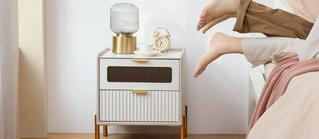
Simple Reflex Agent — Real Example
A robot vacuum that only bumps and turns
When it hits a wall, it turns in a random direction
It does not remember where it has already cleaned
It does not plan a path — it just reacts to each bump
Simple, cheap, but not very efficient
Good enough for small, simple rooms
Basic robot vacuums use simple reflex behavior: bump → turn → repeat
REAL-WORLD EXAMPLE
Early Roomba models used simple reflex behavior. They cleaned rooms by bouncing around randomly — no map, no memory, just reacting to obstacles.
08

Slide 9
Model-Based Agent — Introduction
An agent that keeps track of the past using internal memory
Maintains an internal model (representation) of the world
Can handle partially observable environments better
Updates its model based on new sensor information
Makes decisions based on both current and past information
More capable, but also more complex to build
KEY CONCEPT
A model-based agent is like a person with a good memory. It remembers what it has seen and uses that memory to make better decisions.
REAL-WORLD EXAMPLE
A smart assistant (Siri, Alexa) that remembers your previous commands and preferences to give better responses over time.
09

Slide 10
Model-Based Agent — Architecture
Input: Sensors provide current environment info
Internal State: Memory stores what the agent has learned
Model: A representation of how the world works
Update: The agent updates state with new sensor data
Decision: The agent uses its model to choose an action
Architecture: Sensors → [State + Model] → Actuators
INTERNAL
STATE
SENSORS
DECISION
ACTUATORS
MODEL OF
WORLD
update state
REAL-WORLD EXAMPLE
A self-driving car remembers the position of other vehicles and predicts their movement using its internal model of traffic behavior.
10

Slide 11
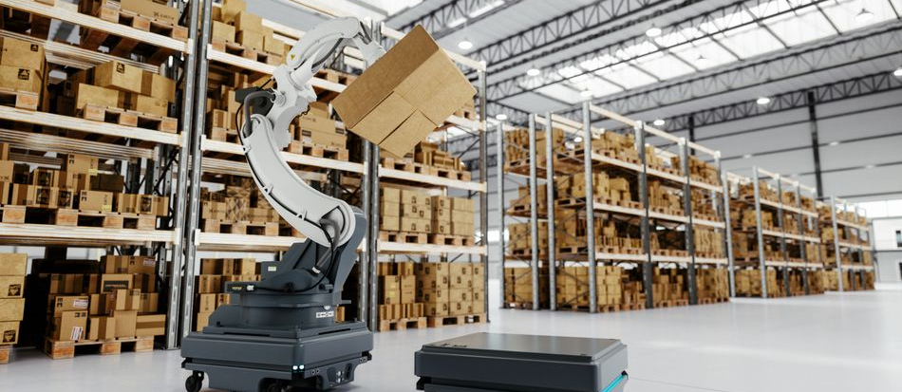
Model-Based Agent — Real Example
A warehouse robot that remembers where items are stored
It builds a map of the warehouse as it moves around
It updates the map when shelves are moved or restocked
It uses the map to find the shortest path to any item
Without memory, it would wander randomly like a reflex agent
With memory, it works efficiently in a large, complex space
Amazon warehouse robots use internal maps to navigate and retrieve packages efficiently
REAL-WORLD EXAMPLE
Amazon warehouse robots (Kiva systems) use internal maps to navigate and retrieve packages — they remember where everything is.
11

Slide 12
Goal-Based Agent — Introduction
An agent that acts to achieve a specific goal or objective
Knows what it wants to accomplish, not just how to react
Can plan a sequence of actions to reach the goal
More flexible than reflex and model-based agents
Can choose different paths or methods to achieve the same goal
The goal guides all decision-making
KEY CONCEPT
A goal-based agent is like a person with a destination in mind. They plan their route and adjust if blocked, because the goal stays fixed.
REAL-WORLD EXAMPLE
A GPS navigation system plans a route to your destination. If a road is closed, it finds a new path — the goal (destination) never changes.
12

Slide 13
Goal-Based Agent — Architecture
Input: Sensors detect the current state
Goal: A clear target or desired future state
Planning: Search for actions to reach the goal
Prediction: Predict what happens after each action
Decision: Choose the action moving closest to the goal
Architecture: Sensors → [Model + Goal] → Planning → Actuators
INTERNAL
MODEL
SENSORS
PLANNING
ACTUATORS
GOAL
STATE
The goal drives the planning process
REAL-WORLD EXAMPLE
A chess AI plans moves to checkmate the opponent. Every move is chosen to get closer to the goal — winning the game.
13

Slide 14
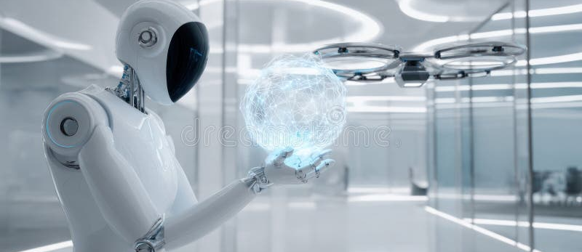
Goal-Based Agent — Real Example
A delivery drone that must reach a specific address
It knows the goal: deliver the package to coordinates X, Y
It plans a flight path considering buildings and weather
If blocked, it finds an alternative route to the same goal
It does not just react — it thinks ahead to reach the destination
The goal stays the same even if the path changes
Delivery drones plan routes to reach specific destinations
REAL-WORLD EXAMPLE
Delivery drones by companies like Zipline plan routes to deliver medical supplies to specific hospitals — the goal is fixed, the path adapts.
14

Slide 15
Utility-Based Agent — Introduction
An agent that chooses the best option based on satisfaction or value
Uses a utility function to measure how good each outcome is
Not just "reach the goal" but "reach it in the best possible way"
Can compare multiple goals and pick the most valuable one
Handles trade-offs: speed vs. safety, cost vs. quality
The most flexible and powerful type of agent
KEY CONCEPT
A utility-based agent is like a person who weighs options. They do not just pick any route — they pick the one that balances time, cost, and comfort.
REAL-WORLD EXAMPLE
A ride-sharing app (Uber, Lyft) balances price, wait time, and driver rating to find the best ride for you.
15

Slide 16
Utility-Based Agent — Architecture
Input: Sensors detect the current state
Goals: Multiple possible goals identified
Utility Function: A scoring system for outcomes
Evaluation: Calculate utility score for each action
Decision: Pick the action with the highest score
Architecture: Sensors → [Model + Goals + Utility] → Best Action
MODEL
SENSORS
EVALUATE
OPTIONS
BEST ACTION
GOALS
UTILITY
The utility function scores and ranks all possible actions
REAL-WORLD EXAMPLE
A self-driving car chooses a route balancing speed, safety, and fuel efficiency — scoring each option to find the best one.
16

Slide 17
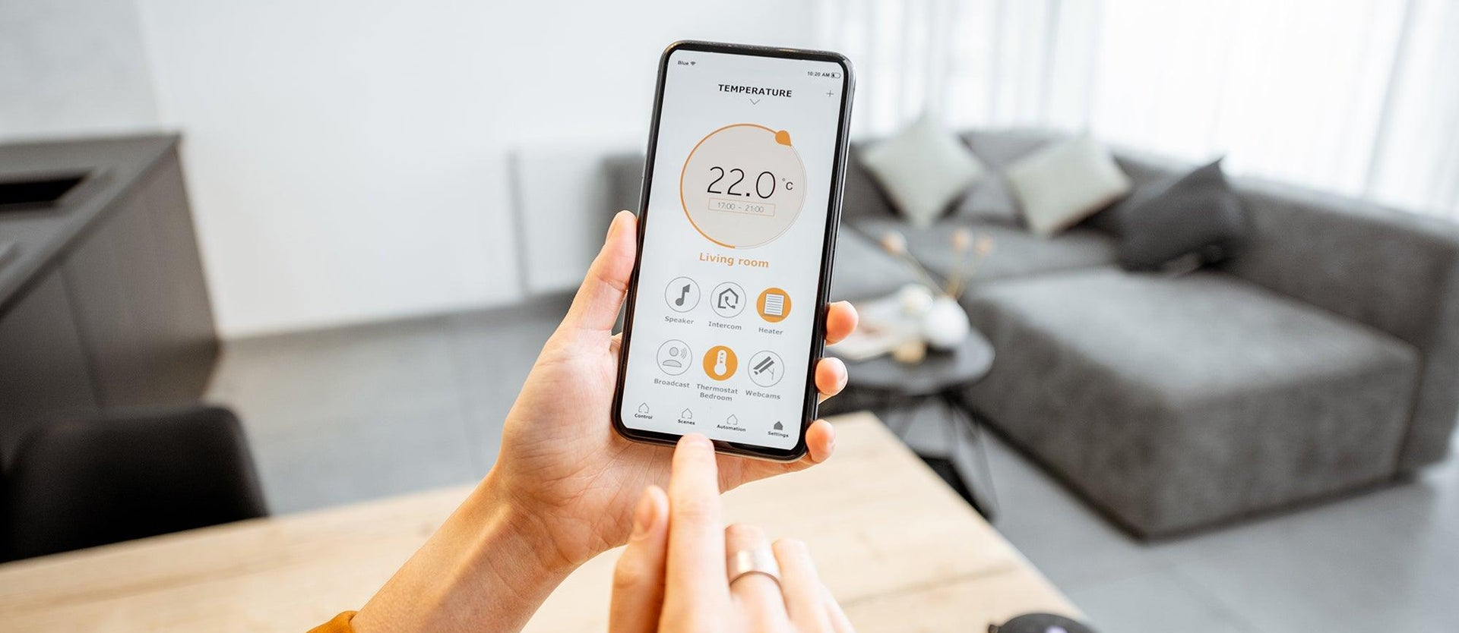
Utility-Based Agent — Real Example
A smart assistant scheduling your day
It considers multiple goals: work, exercise, family time, rest
It scores each possible schedule based on your preferences
It picks the schedule with the highest overall satisfaction
It handles trade-offs: less exercise today for an important meeting
It adapts when priorities change
Smart scheduling considers multiple constraints and preferences
REAL-WORLD EXAMPLE
Google Calendar's smart scheduling suggests the best meeting times by considering multiple constraints and preferences.
17

Slide 18
Comparing All Agent Types
Feature | Simple Reflex | Model-Based | Goal-Based | Utility-Based
Memory | None | Internal State | Internal State | Internal State
Planning | No | No | Yes | Yes
Goal Awareness | No | No | Yes | Yes
Scoring/Ranking | No | No | No | Utility Function
Each type builds on the previous one, adding more capability. Real AI systems often combine features from multiple types.
REAL-WORLD EXAMPLE
A modern self-driving car uses all four: reflex for emergency braking, model-based for tracking, goal-based for routing, utility-based for comfort.
18

Slide 19
02
Environment in AI
Where Agents Live and Work

Slide 20
What Is an Environment?
The environment is everything outside the agent that it interacts with
It includes all the information, objects, and rules the agent must deal with
The environment can be physical (real world) or virtual (software, games)
Agents must understand their environment to make good decisions
Different environments require different types of agents
The environment is the entire context of operation — not just the "place"
ENVIRONMENT
AGENT
Objects | Rules | Information | Other Agents
REAL-WORLD EXAMPLE
For a chess AI, the environment is the chessboard, the rules, and the opponent's moves — all contained within the game context.
20

Slide 21
Environment Properties Overview
AI environments are classified by four key properties. Each property has two opposite values.
Visibility
Predictability
Time Connection
Change Speed
Accessible vs Inaccessible
How much can the agent see?
Deterministic vs Non-Deterministic
Are outcomes predictable?
Episodic vs Non-Episodic
Are decisions connected?
Static vs Dynamic
Does the environment change?
REAL-WORLD EXAMPLE
A video game world can be fully visible (accessible), predictable (deterministic), level-by-level (episodic), and frozen when paused (static).
21

Slide 22
Accessible vs Inaccessible Environment
ACCESSIBLE (Fully Observable)
INACCESSIBLE (Partially Observable)
The agent can see all relevant information at once
Chess is accessible — the whole board is visible
Accessible environments are easier to handle
The agent can only see part of the environment
Poker is inaccessible — you cannot see opponent cards
Requires memory and prediction (model-based agents)
REAL-WORLD EXAMPLE
A traffic camera sees all lanes (accessible). A self-driving car in fog sees only nearby objects (inaccessible).
22

Slide 23
Deterministic vs Non-Deterministic
DETERMINISTIC (Predictable)
NON-DETERMINISTIC (Unpredictable)
The same action always produces the same result
Chess is deterministic — moving a piece always has the same effect
Deterministic environments are predictable and easier to plan in
The same action may produce different results
Rolling dice is non-deterministic — you cannot predict the outcome
Requires agents to handle uncertainty and adapt
REAL-WORLD EXAMPLE
A factory robot on an assembly line (deterministic) vs. a robot driving on a busy street (non-deterministic).
23

Slide 24
Episodic vs Non-Episodic Environment
EPISODIC (Independent Steps)
NON-EPISODIC (Connected Decisions)
Each decision is independent — past does not affect future
Image classification is episodic — each photo is judged separately
Episodic tasks are simpler — no long-term planning needed
Decisions are connected — past choices affect future options
A strategy game is non-episodic — early moves shape late game
Requires memory and strategy across time
REAL-WORLD EXAMPLE
A spam filter checking each email (episodic) vs. a stock trading AI where today's trade affects tomorrow's position (non-episodic).
24

Slide 25
Static vs Dynamic Environment
STATIC (No Change)
DYNAMIC (Constantly Changing)
The environment does not change while the agent decides
A crossword puzzle is static — the board waits for you
Static environments give the agent unlimited time to decide
The environment changes even while the agent thinks
A soccer game is dynamic — players move while you plan
Requires fast reactions and continuous updates
REAL-WORLD EXAMPLE
A chess app (static, board waits) vs. a drone racing game (dynamic, obstacles move constantly).
25

Slide 26
Environment Types at a Glance
System | Accessible? | Deterministic? | Episodic? | Static?
Chess Game | Yes | Yes | No | Yes
Self-Driving Car | No | No | No | No
Image Recognition | Yes | Yes | Yes | Yes
Stock Trading | No | No | No | No
Robot Vacuum | Partial | Yes | No | No
Real-world AI must handle the hardest combination: inaccessible, non-deterministic, non-episodic, dynamic.
REAL-WORLD EXAMPLE
Self-driving cars face the hardest environment type, which is why they are so difficult to build.
26

Slide 27
Matching Agents to Environments
Simple environments → Simple reflex agents work fine
Partially known environments → Model-based agents are needed
Goal-oriented tasks → Goal-based agents are required
Complex trade-off situations → Utility-based agents are best
The harder the environment, the smarter the agent needs to be
Good AI design matches the right agent to the right environment
Simple Env
Reflex Agent
Partial Info
Model Agent
Goal Tasks
Goal Agent
Complex Trade-offs
Utility Agent
REAL-WORLD EXAMPLE
A smart thermostat (simple, static) uses reflex rules. A self-driving car (complex, dynamic) uses utility-based planning.
27

Slide 28
Real-World AI Systems
Smart Assistants
Recommendation Systems
Game-Playing AI
Siri, Alexa
Model-based + Goal-based
Partially accessible, dynamic
Netflix, Amazon
Utility-based
Accessible, static
AlphaGo, Chess AI
Goal-based + Utility-based
Accessible, static
Medical Diagnosis AI
Industrial Robots
Self-Driving Cars
IBM Watson Health
Model-based + Utility-based
Partially accessible, static
Assembly Line Bots
Simple reflex or Model-based
Accessible, deterministic
Tesla, Waymo
All four types combined
Inaccessible, dynamic
REAL-WORLD EXAMPLE
Netflix recommends movies by scoring options (utility) based on your viewing history (model).
28

Slide 29
Key Takeaways Recap
1
An AI agent perceives its environment and acts to achieve objectives
2
Four agent types: Reflex, Model-Based, Goal-Based, Utility-Based
3
Each type adds more capability: memory, goals, and scoring
4
Environments differ in visibility, predictability, time connection, and change speed
5
The hardest environments need the smartest agents
Real AI combines multiple agent types to handle complex, real-world tasks
From simple door sensors to self-driving cars — the same principles scale to all AI
29

Slide 30

THANK YOU
Questions & Discussion
Artificial Intelligence — Intelligent Agents and Environment Properties
Week 3 Lecture 5 & 6

